Slide 1
What and Where is Technical pedagogy in Creative Education?
An investigative approach to understanding technical teachings and careers.

Slide 2
Context: Technical Pedagogy.
Rebranding of 'third space' pedagogy
Built from a rhizomatic/scaffold approach to student learning
Characterised by deliberate practice (demonstrative).
Technical career pathways (Staff development/Innovation)
Community teaching practice (Staff retention/Sustainability)
Democratic leadership. (Staff Moral/ workplace engagement)
“This was particularly striking for activities such as designing lesson plans and course curricula, for which creative arts technicians were more than twice as likely to be involved.” Wragg, Harris, Noyes and Vere 2022
Notes:
The core methods to this action research project are,
democratically developing the pedagogic structure
as well as systemically building the technical career pathways
Built through community, inclusivity and technical foresight.

Slide 3
Rationale: 'Broken windows'
The reasoning behind this project is due to the barriers that are in place with technical positions and opportunities, even with the PgCert course, the focus is clearly on setting the Academic perspective and with lived experiences from staff and myself we are innovating a change to the system to gain respect and equal opportunity in the workplace.
“We are mainly valued by students constantly, but never from anyone else. The job of the technician is always backstage, as it should be, but it would be nice to be supported and valued. When I say valued, [that] means professionally valued, not just receiving the odd email saying “well done to all”. (Technician A)” Clare Sams 2016
“For technicians with aspirations to transition their own careers to academia the message of this study appears to be: excel as a technician; engage with professional development activities; earn the academic credentials on offer; collaborate with academic colleagues; and continue with your own practice and gain research insights” Tim Savage 2018.
Notes:
* Lived experience of personal actions that conflicted towards single perspective narratives and barriers in opportunities * Sams provided evidence to indicate similar displacements from technical staff and being under-valued. * Savage, suggests technical staff should excel as technicians while engaging in personal develop and academic credentials.

Slide 4
"UAL needs an academic workforce with the different skills to deliver teaching, research and knowledge exchange. The academic Career Pathways project is designed to recognise, develop and reward careers in these mission areas."
Taken from the UAL Canvas Website: Academic career pathways.
Notes:
* I believe UAL needs a balanced workforce of both academic and technical skill sets that showcase a 'visible' variety of teaching. * Encouraging all staff to engage with a range of pathways to innovate, challenge and develop teaching environments and student learning.

Slide 5
Research methods
Autoethnographic experiences
Qualitative Research methods
Thematic analysis
Deductive codex
Reflection trajectory
Topical narrative extract
Focus group (live in person)
Forum/Survey
Abductive future?
Notes:
* research methods are a combination of auto-ethnographic topical narration and qualitative methods. * Using a focus group with a forum, around the topics of technical staff and pedagogy. * The concluding research method is challenging the purpose of our career longevity, staff retention and technical opportunities.

Slide 6
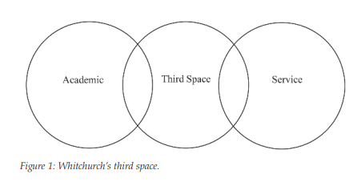
What are 'Third Space' Educators (TSEs)?
"The shifting boundaries between academic and technical camps are under-researched. Arguably most relevant is Whitchurch’s concept of a ‘third space’ (2008) located between camps in which a new type of boundary-crossing hybrid HE worker resides. Figure 1 visualizes Whitchurch’s third space as a Venn diagram. " Tim Savage 2018
Pracademic
Tech-ademic
Reflective Practitioner
Instructional practitioner (online)
Technical Tutor
Studio Tutor
“Nurturing pracademics’ practice-informed teaching, professional values, networks and identities could realise myriad benefits for the in individual, the student experience and the HEI.” Dickinson, Fowler and Griffiths 2020
Notes:
3rd space educators are a field of teaching and learning practitioners who navigate both worlds of service and academia.
Dickinson, Fowler and Griffiths, indicate the positives of practice-informed teaching and how it benefits the students experience and HEI.
Why have so many labels for practitioners who teach, can my research provide a solid title on 3rd space practiitioners?

Slide 7
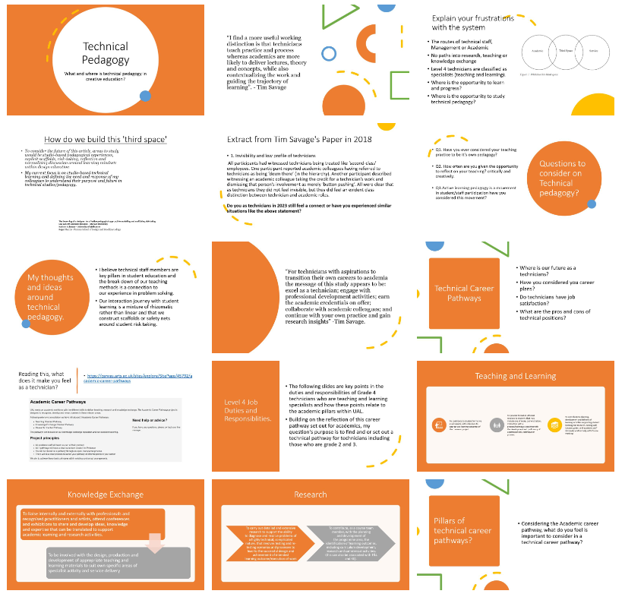
The Focus Group / Post forum
Democratic discussion
Challenging third space pedagogy
Empathy relation with other technical insights.
Breaking down lvl4 job roles and responsibilities
Relating job roles to teaching, KE or Research.
Community discussion on the missing technical pillars.
Forum to allow time to digest the conversation.
16 participants
Notes:
PROS CONS * A great turn out between level 3 to level 5 technicians. *Singular topics would've allowed more time to digest.
* Power point stablised the conversations * Hard to manage due to date/time
* Held in a safe, technical owned space. * Could've provided pre-task insight
* Encouraged people to listen, compare and revisit their career. * 1 hour wasn't enough.
* Everyone felt present and engaged. * Note taking: too much for big groups, a lot of voices /Vocialised participants/dominating

Slide 8
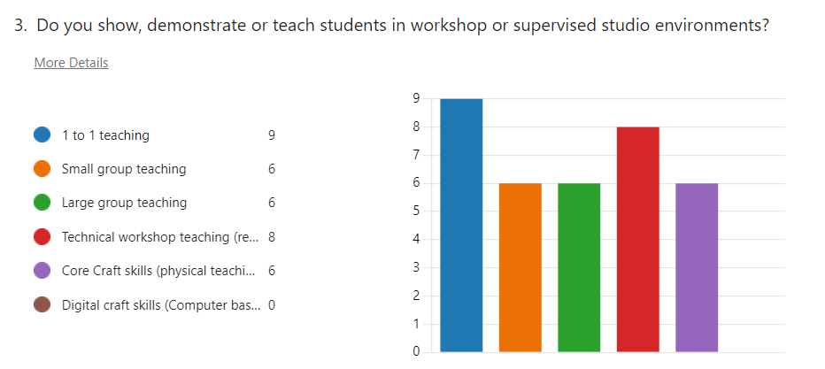
The Forum:
10 participants out of 16
14 Questions, further carried on from the focus group.
Section 1: Technical pedagogy.
Section 2: Technical Career plans
Range of multiple choice and long written answers.
'Other' Responses option to add to the research.
Simple to complex structure.
Notes:
Q3 – Was an insight question into the fields of teaching of partcipants practiced within their teaching and learning roles/ Q9 – Explores the involvement of recruiting from within, and creating opportunities for our level 2 and level 3 technicians. With the forums fellow up questions, I tried to explore/cover the technical spectrum making sure all voices had a place at the table.

Slide 9
Thematic Analysis: Deductive codex
Code | Description | Evidence
Under-Valued | what I am looking for here, is evidence on staff feelings, job satisfaction and staff moral around the workplace. | Tim Savage 2018
Opportunity | What I am looking for here, is evidence of technical staff having the opportunity to explore their practice, research or develop their skills within their own practice as well as teaching and learning. | Dickinson, Fowler and Griffiths 2020
Third-Space practitioners. | what I am looking for here, is evidence that technical staff are teaching a wide variety of scenarios, 1-2-1 teaching, workshops, small group and large group etc. | Tim Savage 2018 Whitchurch 2008 Vygotsky Wragg, Harris, Noyes and Vere 2022
Practice and process | What I am looking for here, is evidence that technical staff are developing a pedagogy or using a pedagogy around that is focused on process and practice of skill building and student knowledge development with critical thinking. | McLain 2017 Vygotsky
Deductive based on lived experiences as well as relating to literature evidence.
Open to leading to abductive coding from gather evidence.
Possibilities to explore other research methodologies.
Notes:
* The deductive codex, came from my own topical narrative and picked up interesting directions from my research. * I use the deductive method, to establish an easier connection between my experience and my colleagues. To see if the evidence was true to my statements.

Slide 10
Thematic analysis: Findings
Theme | Evidence | Conclusion
Theme 1: Under Valued (Staff feelings, Job Satisfaction, Staff morale) | Responses affirm the technicians' feelings of being treated as 'second-class' employees. The desire for more staff and recognition is also evident | Theme 1, shows that my research theme does provide evidence that technical staff are under-valued.
Theme 2: Opportunity (Technical staff development) | Responses suggest interest in external teaching/training and upskilling in specific areas. Some responses highlight a lack of research opportunities and innovation. | Theme 2, shows that there is a lack of opportunity for technical staff, as well as the need for external training/qualifications.
Theme 3: Third Space Practitioners (Teaching variety) | Responses showcase a variety of teaching scenarios, including technical workshops, supervised studios, and 1-1 teaching, aligning with the concept of Third Space Practitioners. | Theme 3, shows that majority of the technical teaching teams are third space practitioners.
Theme 4: Practice and Process (Pedagogy, Skill building, Critical thinking) | Responses provide detailed descriptions of teaching scenarios, emphasizing practical demonstrations, hands-on learning, and individualized guidance, supporting the focus on practice and process | Theme 4, shows evidence supporting that technical teaching and learning environments are based around practice and process.
“Deliberate practice is described as taking purposeful practice further, enhanced by proven techniques developed by experts, with a mentor figure playing an important role, providing real-time feedback, alongside the self-reflection (internal feedback) of the practitioner." McLain 2017 (Practice and Process)
Notes:
* The evidence suggests that technicians are under-valued, and seek recognition, opportunities for development. * Technicians provide a variety of teaching scenarios, with a focus on practice and process and are third space practitioners. * Technicians showed interest in exploring collaboration through knowledge exchange and research opportunities. * There are also indications of a desire for career development, improved job satisfaction, and engagement in decision-making processes.
* McLain provides evidence that deliberate practice in taking purposeful practice futher, could play an important role not only to students but the practitioner themselves.

Slide 11
Additional Themes found: Abductive future
Additional themes | Evidence
Career Development and Satisfaction | Discussions on areas of interest for career development, suggesting that career trajectory and job satisfaction are important concerns.
Knowledge Exchange | Responses emphasize the benefits of knowledge exchange, suggesting potential for collaboration, skill swaps, and fostering new ways of working.
Research Opportunities | Responses highlight the potential benefits of research opportunities for personal and departmental growth, innovation, and improved pedagogy.
Participation in PG-cert | Responses indicate mixed opinions on the PG-cert, with some considering it beneficial for personal knowledge and teaching approaches
Focus Group Experience | Responses express positive experiences with the focus group, indicating a desire for regular meet-ups and the need for continued communication among technicians.
Notes:
* These additional themes are inductive coding, that combined with my original set of codes, would bring an abductive codex to further research. * This combined method could provide a more solid methodology to gathering evidence, while also fine tuning the methods for a wider audience, in UAL or HEI.

Slide 12
Further Developing my ARP: Divide and Conquer
Theme | Further evidence
Under Valued | Conduct interviews or focus groups to delve deeper into the feelings of being undervalued. Ask open-ended questions about specific instances or experiences that contribute to this perception. Explore staff turnover rates, absenteeism, or any available data that might indicate dissatisfaction among technical staff.
Opportunity | Create a survey to gather detailed responses on the specific opportunities technical staff desire, such as access to training programs, involvement in research projects, or exposure to innovative practices. Conduct one-on-one interviews to understand individual aspirations and expectations for career development.
Third Space Practitioners | Observe or shadow technical staff during their teaching activities to gain firsthand insights into the variety of scenarios they handle. Conduct interviews to explore the challenges and benefits of teaching in different scenarios, and how it aligns with the concept of Third Space Practitioners.
Practice and Process | Examine course materials, syllabi, and teaching plans to understand how technical staff integrate practice and process into their teaching methodologies. Conduct in-depth interviews or focus groups to explore the pedagogical approaches employed by technical staff and their perceptions of the effectiveness of these methods.
Further Evidence methods:
Surveys:
Develop targeted surveys with questions specifically designed to gather quantitative data on staff perceptions, experiences, and preferences related to each theme.
Interviews:
Conduct in-depth interviews to allow staff to express their thoughts, experiences, and opinions more elaborately, providing rich qualitative data.
Focus Groups:
Organise focus groups with a diverse representation of technical staff to encourage open discussions and the sharing of varied perspectives.
Document Analysis:
Analyse relevant documents, such as official reports, meeting minutes, or departmental communications, to identify any implicit or explicit mentions of the themes.
Observations:
Personally observe teaching sessions, workshops, or other activities to gain insights into the daily practices and challenges faced by technical staff.
Notes:
* Concluding my findings, I do feel there is enough evidence to my themes, to investigate this into another Action research cycle. * While channelling my deductive codex, I will expand each theme into it’s own investigative pathway using the abductive codex. * Using new methods to collect data, like 1-2-1 Interviews, observations and document analysis, potentially could highlight key assets to technical pedagogy

Slide 13
What’s Next: ‘Tech Talks’ and ‘Hot Press’
TECH’ TALKS
HOT PRESS
Better posters soon
Thank you,
Sean-Henry Fitzsimons Hybrid practitioner (lost between two worlds).
Notes:
*Tech talks are inspired by the micro teaching environments, to encourage technical staff an opportunity to test and explore teaching practices/research. With the 20/10 time frame. *Hot Press is part of my Irish culture and is/was a room that while the fire was on, the boiler keep your laundry warm. It’s a time and location for technical staff to be open to honest, transparent community discussions on present and future technical roles.

Slide 14
References
Advance HE (2018). Technicians: Fellowship as a stepping stone to academia | Advance HE. [online] www.advance-he.ac.uk. Available at: https://www.advance-he.ac.uk/news-and-views/Technicians-Fellowship-as-a-stepping-stone-to-academia [Accessed 12 Jan. 2024].
Blair, E. and Briggs, G. (2019). A tribe hidden in plain sight: the ambiguous role of the instructor in a Caribbean university. Journal of Higher Education Policy and Management, 41(3), pp.292–305. doi:https://doi.org/10.1080/1360080x.2019.1596388.
Bryman, A. (2007). Effective leadership in higher education: a literature review. Studies in Higher Education, 32(6), pp.693–710. doi:https://doi.org/10.1080/03075070701685114.
Dickinson, J., Fowler, A. and Griffiths, T.-L. (2020). Pracademics? Exploring transitions and professional identities in higher education. Studies in Higher Education, 47(2), pp.1–15. doi:https://doi.org/10.1080/03075079.2020.1744123.
Grocott, L., McEntee, K., Coleman, K. and Manix, R. (2019). The becoming of a designer: An affective pedagogical approach to modelling and scaffolding risk-taking. Art, Design & Communication in Higher Education, 18(1), pp.99–112. doi:https://doi.org/10.1386/adch.18.1.99_1.
Hahn Tapper, A.J. (2013). A Pedagogy of Social Justice Education: Social Identity Theory, Intersectionality, and Empowerment. Conflict Resolution Quarterly, 30(4), pp.411–445. doi:https://doi.org/10.1002/crq.21072.
McLain, M. (2017). Emerging perspectives on the demonstration as a signature pedagogy in design and technology education. International Journal of Technology and Design Education, 28(4), pp.985–1000. doi:https://doi.org/10.1007/s10798-017-9425-0.
McLain, M. (2019). Developing perspectives on ‘the demonstration’ as a signature pedagogy in design and technology education. International Journal of Technology and Design Education, 3(26). doi:https://doi.org/10.1007/s10798-019-09545-1.

Slide 15
References continued
Spark: UAL Creative Teaching and Learning Journal How do art and design technicians conceive of their role in higher education? Artist (formerly a Technician at Central St Martins). Spark: UAL Creative Teaching and Learning Journal, 1(2), pp.62–69.
Savage, T. (2018). Creative arts technicians in academia: To transition or not to transition? Art, Design & Communication in Higher Education, 17(2), pp.237–253. doi:https://doi.org/10.1386/adch.17.2.237_1.
Savage, T. (2019). Challenging HEA Fellowship: Why should technicians in creative arts HE be drawn into teaching? Art, Design & Communication in Higher Education, 18(2), pp.201–218. doi:https://doi.org/10.1386/adch_00007_1.
Stommel, J. (2018). Radical Openness: the Work of Critical Digital Pedagogy. [online] www.slideshare.net. Available at: https://www.slideshare.net/jessestommel/radical-openness-the-work-of-critical-digital-pedagogy [Accessed 12 Jan. 2024].
University of the Arts London and Corrall, S. (2017). CAREER PATHWAYS -DISCUSSION DOCUMENT Academic Career Pathways Project. The Exchange.
Wragg, H., Harris, C., Noyes, A. and Vere, K.-A. (2023). Technicians as teachers: the emerging role of technical staff within higher education teaching and learning environments. Journal of Further and Higher Education, 47(9), pp.1–15. doi:https://doi.org/10.1080/0309877x.2023.2231380.
Yosief, A., Sulieman, M.-S. and Biede, T. (2022). Improving the practices of teacher educators through collaborative action research: challenges and hopes. Educational Action Research, pp.1–18. doi:https://doi.org/10.1080/09650792.2022.2066147.
Zhao, F., Liang, S., Ma, J. and Ou, Q. (2023). Research on the innovation of teaching mode of vocational and technical education. SHS web of conferences, 166, pp.01078–01078. doi:https://doi.org/10.1051/shsconf/202316601078.

